Slide 1
Logistic Regression

Slide 2
Classification
Where y is a qualitative value
Develop the logistic regression algorithm to determine what class a new input should fall into
Classification problems
Email -> spam/not spam?
Online transactions -> fraudulent?
Tumor -> Malignant/benign

Slide 3
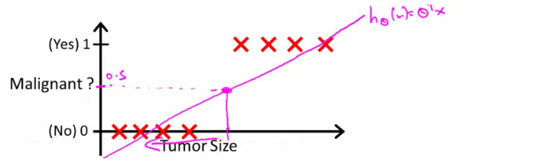
Binary Classification
Y is either 0 or 1
0 = negative class (absence of something)
1 = positive class (presence of something)
Can we use Linear Regression ?

Slide 4
Binary Classification
We could use linear regression
Then threshold the classifier output (i.e. anything over some value is yes, else no)
In our example above linear regression with thresholding seems to work
Issue is
You can have y >1 and y <0
Fails if we need to classify more than 2 classes

Slide 5
Binary Classification
We want our classifier to output values between 0 and 1
For classification hypothesis representation we do h_{θ}(x) = g((θ^{T} x))
g(z) = 1/(1 + e^{-z})
This is the sigmoid function, or the logistic function

Slide 6
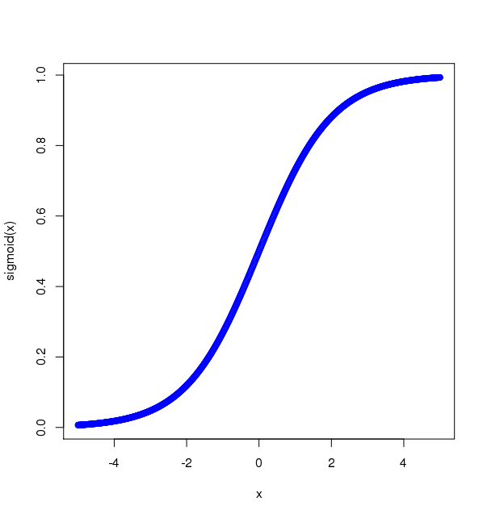
Sigmoid Function
Sigmoid Function
x <- seq(-5, 5, 0.01)
plot(x)
sigmoid = function(x) { 1 / (1 + exp(-x))}
plot(x, sigmoid(x), col='blue')

Slide 7
Sigmoid Function
Crosses 0.5 at the origin, then flattens out]Asymptotes at 0 and 1
Given this we need to fit θ to our data

Slide 8
Interpreting hypothesis output
When our hypothesis (h_{θ}(x)) outputs a number, we treat that value as the estimated probability that y=1 on input x
h_{θ}(x) = 0.7 Tells a patient they have a 70% chance of a tumor being malignant
We can write this using the following notation h_{θ}(x) = P(y=1|x ; θ)
What does this mean?
Probability that y=1, given x, parameterized by θ

Slide 9
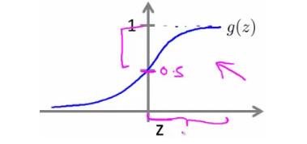
Decision boundary
g(z) is greater than or equal to 0.5 when z is greater than or equal to 0
z is positive, g(z) is greater than 0.5 when
θ^{T} x >= 0
So what we've shown is that the hypothesis predicts y = 1 when θ^{T} x >= 0
The corollary of that when θ^{T} x <= 0 then y = 0

Slide 10
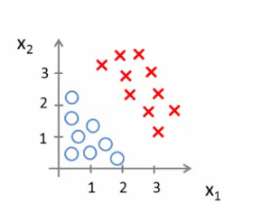
Decision boundary
h_{θ}(x) = g(θ₀ + θ₁x₁ + θ₂x₂)
So, for example
θ₀ = -3
θ₁ = 1
θ₂ = 1
We predict "y = 1" if
-3 + x₁ + x₂ >= 0
Similar we can use polynomial to decide the complex decision boundary

Slide 11
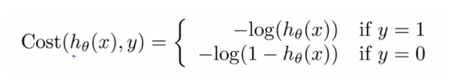
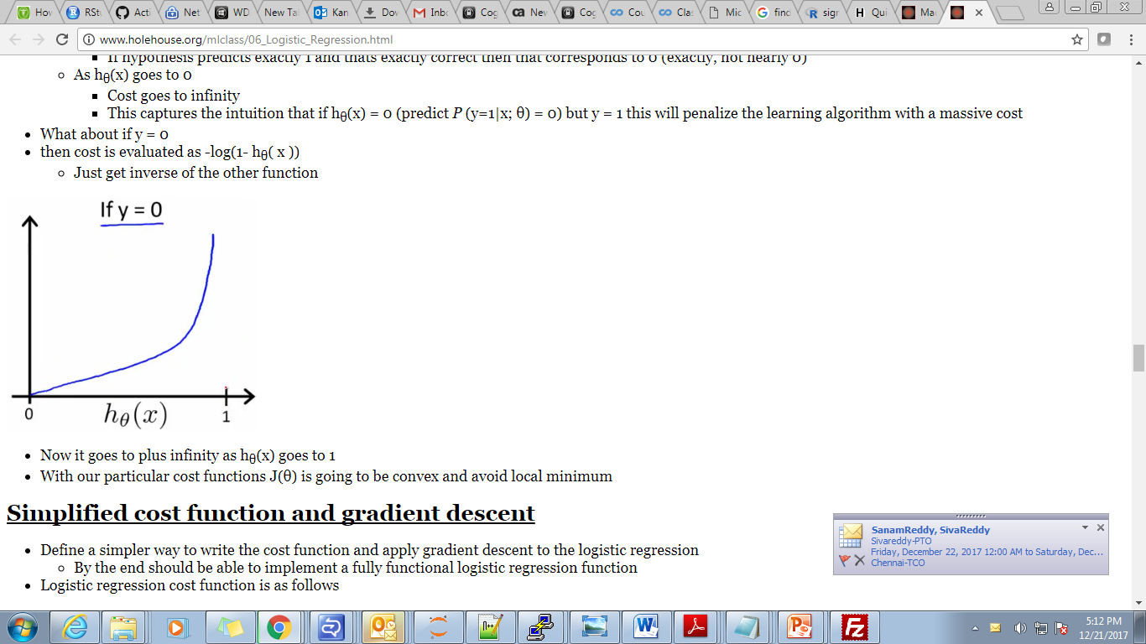
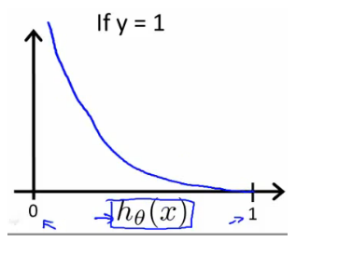
Cost Function
Cost Function for Logistic Regression
Case

Slide 12
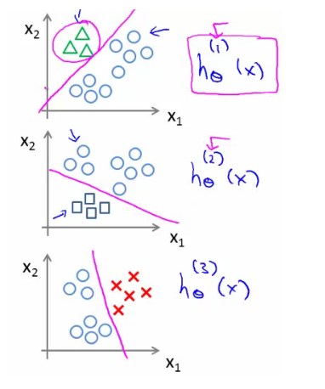
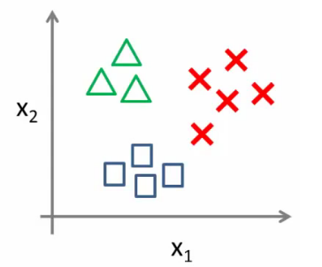
Multiclass classification problems
One vs all
On a new input, x to make a prediction, pick the class i that maximizes the probability that h_{θ}^{(i)}(x) = 1

Slide 13
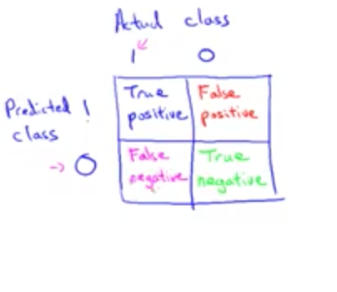
Evaluation Metrics
Confusion Matrix
Precision
Of all patients we predicted have cancer, what fraction of them actually have cancer= true positives / # predicted positive
Recall
Of all patients in set that actually have cancer, what fraction did we correctly detect= true positives / # actual positives
F Square = 2PR / (P+R)

Slide 14
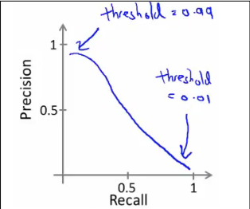
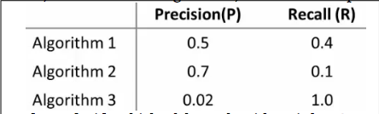
Evaluation Metrics
Trading off precision and recall
F Square = 2PR / (P+R)

Slide 15
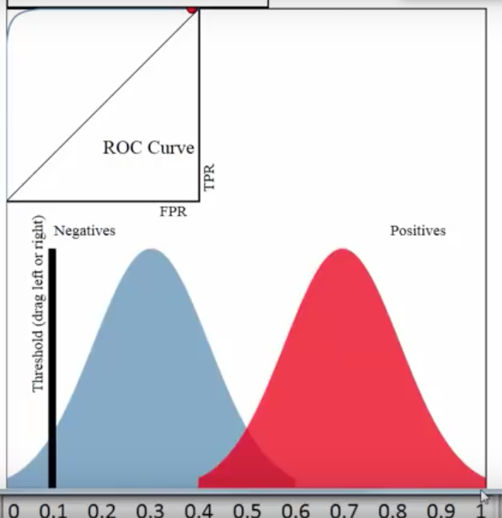
ROC Curve

